Slide 1
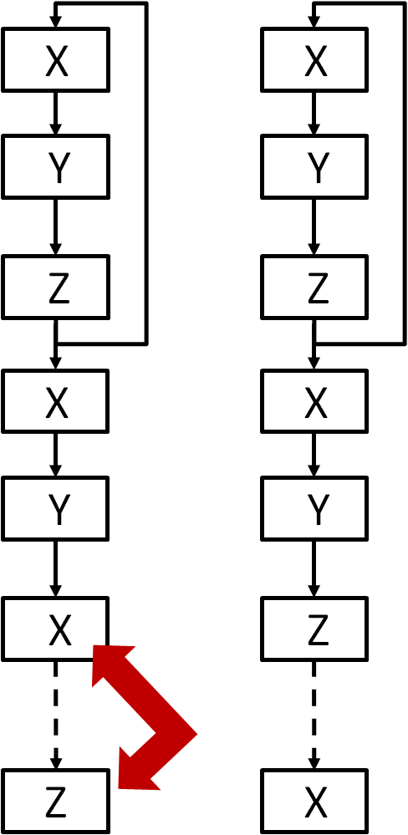
X'
Pipeline
Prologue
Y
X
Z
Y
X
Pipeline
Full
Z
Pipeline
Epilogue

